Slide 1
Intro

Slide 2
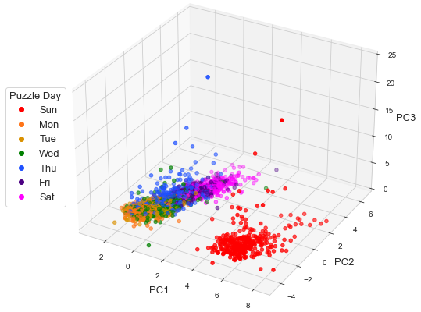
Notes:
Fig. 1

Slide 3
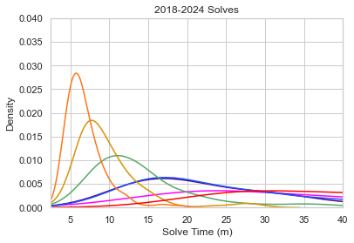
Notes:
Fig. 2

Slide 4
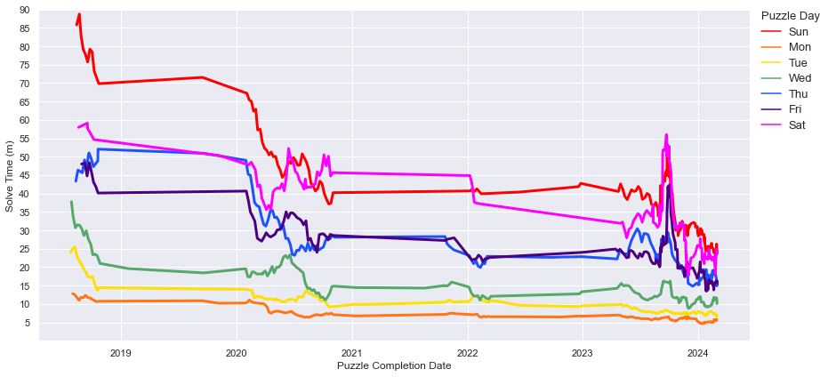
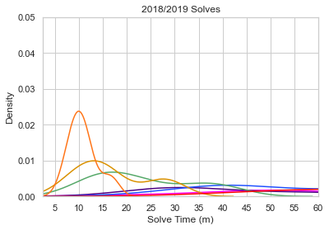
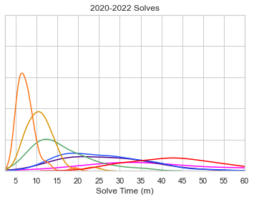
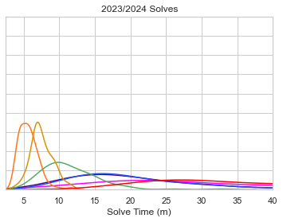
Notes:
Fig. 2

Slide 5
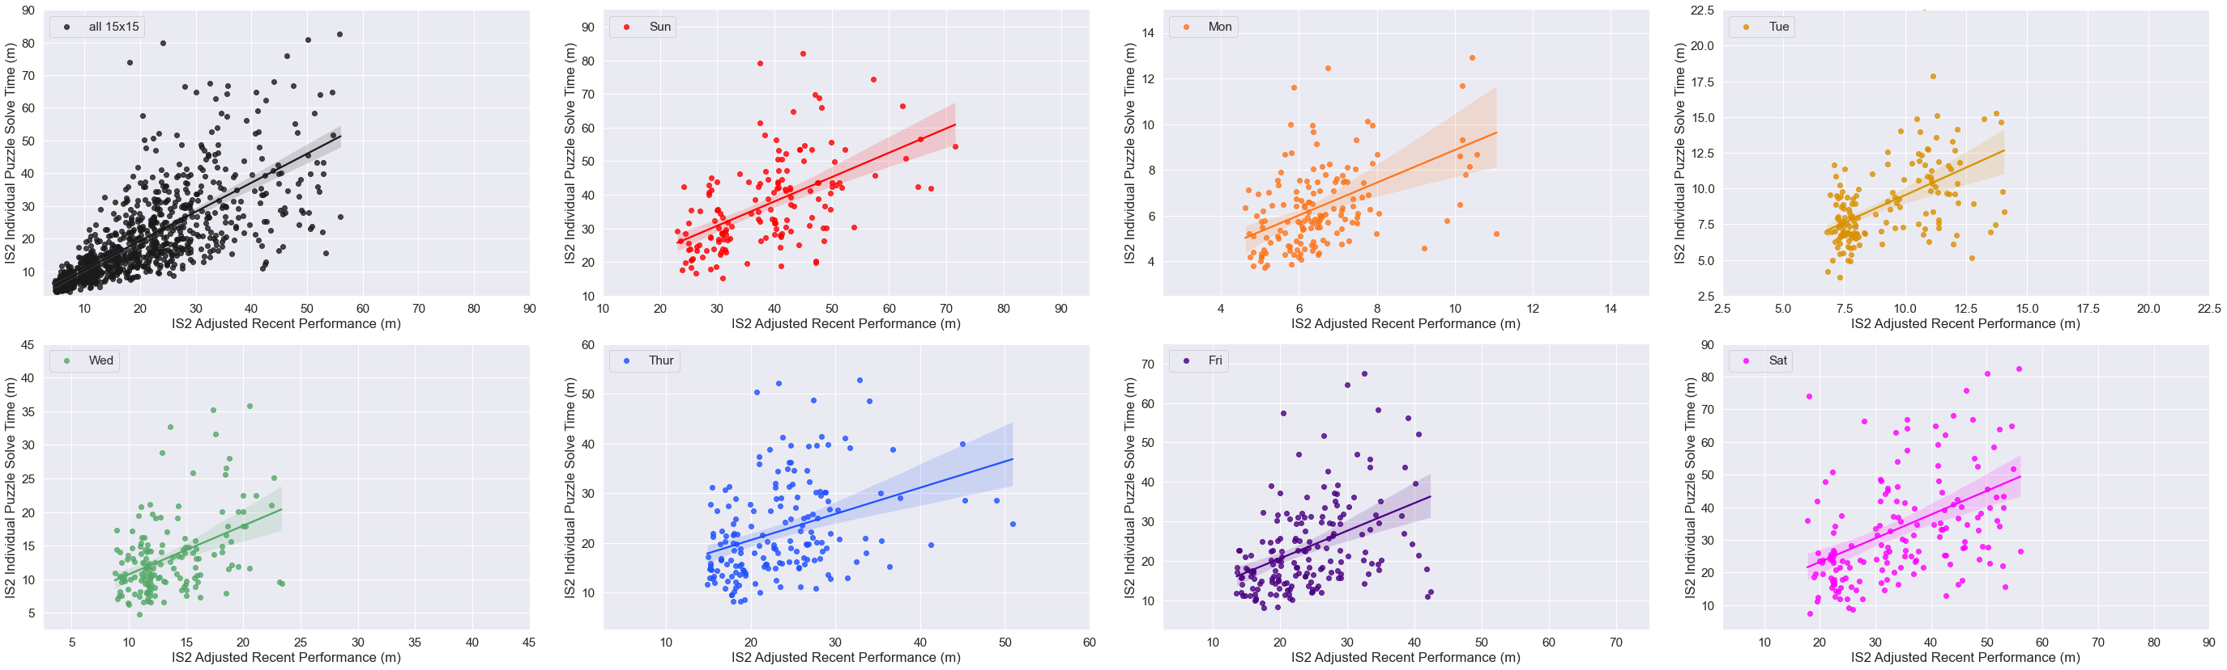
Notes:
Fig. 22

Slide 6
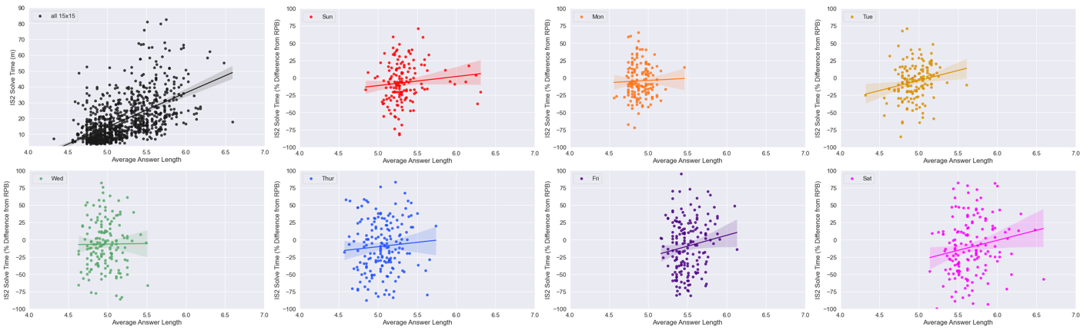
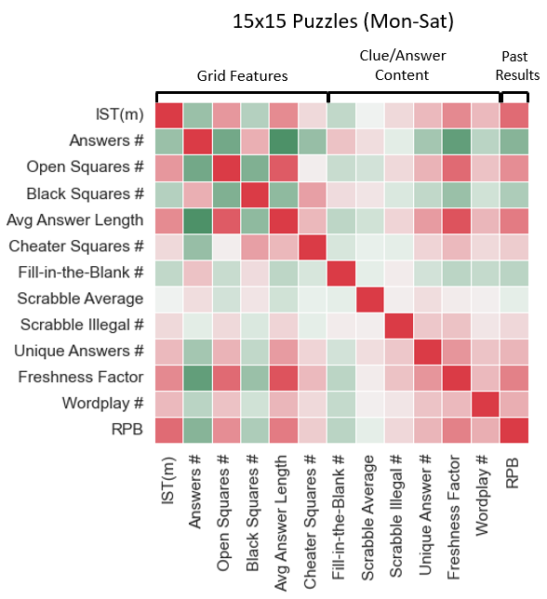
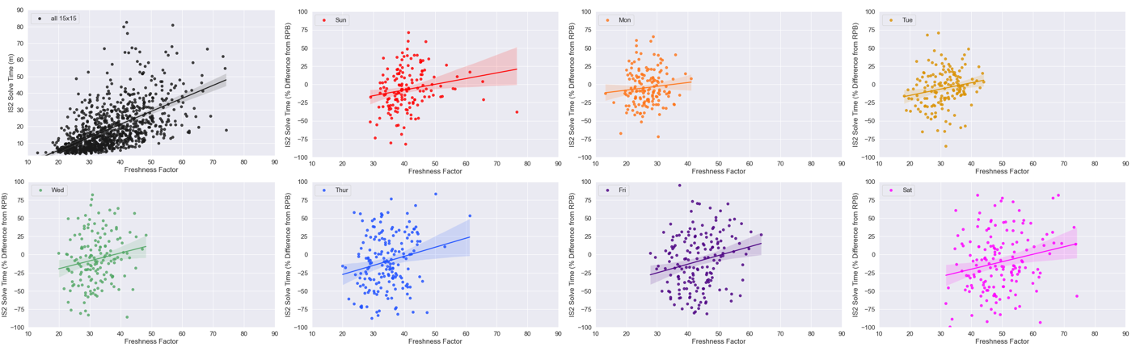
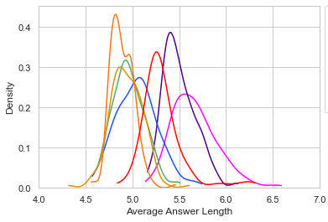
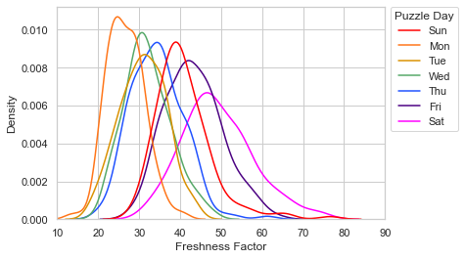
B
A
C
Notes:
Figure 5

Slide 7
Methods

Slide 8
Solver Past Performance Features (n=6)
‘Strength of Schedule’-Adjusted
(n=2/6)
PREDICTED 15x15 PUZZLE
(TARGET FEATURE: IS2 RAW SOLVE TIME)
Circadian
Features
(n=3)
0
Puzzle: Clue or Answer Features
(n=19)
Feature Adjusted by ‘Strength of Schedule’ (SOS) Ratio:
GMS Performance on These Puzzles/GMS Recent Performance Prior to These Puzzles
IS2
Recent Past
Performance
Features
Accrued
Puzzle Day of Week
(n=1)
# Day-Specific Puzzle Prior to Predicted Puzzle
No Time-Decay
Weighting in
Final Model
Puzzle: Grid Features
(n=11)
-10
Notes:
Fig. 2

Slide 9
Results

Slide 10
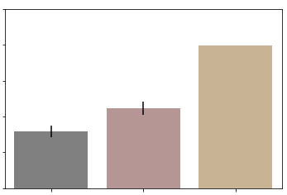
16
14
12
Training Error in minutes (RMSE)
10
8
6
Best Model
Mean PDS IST
Dummy
Benchmark Models
Notes:
Fig. 7

Slide 11
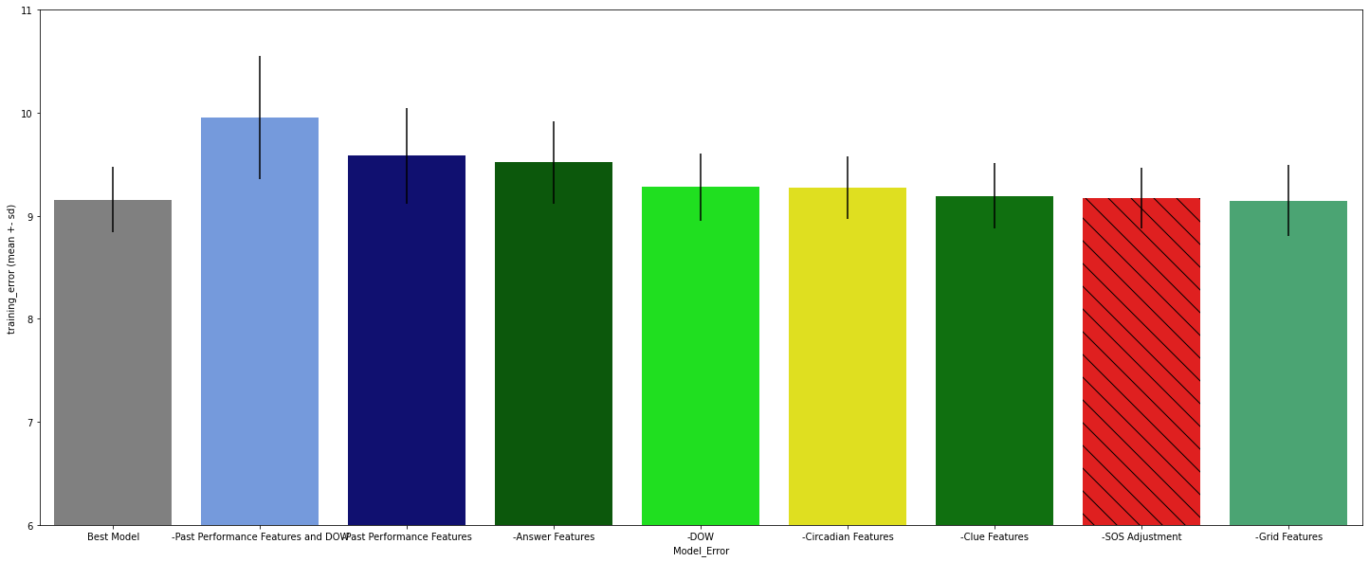
11
10
9
Training Error in minutes (RMSE)
8
7
6
Full Best Model
Past Performance
AND DOW
Past Performance
Answer
DOW
Circadian
Clue
SOS Adjustment
Grid
Subtracted Feature Class or Adjustment Type
Notes:
Fig. 8

Slide 12
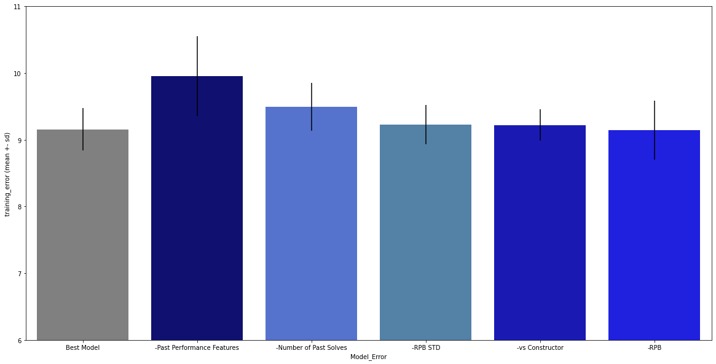
11
10
9
Training Error in minutes (RMSE)
8
7
6
Full Best Model
All Past Performance Features
# Past Solves
(Day Specific or Non-DS)
Std of Recent Performance Baseline
Past Performance vs Constructor(s)
Recent Performance Baseline
(‘Prior Solves # - DS’)
(‘Prior Solves # -NDS’)
(IS Solves l7)
(‘IS_RPB_l10_stdev’)
(‘IS Past Perf vs Constr’)
(‘IS_RPB_l10’)
Subtracted Past Performance Feature(s)

Slide 13
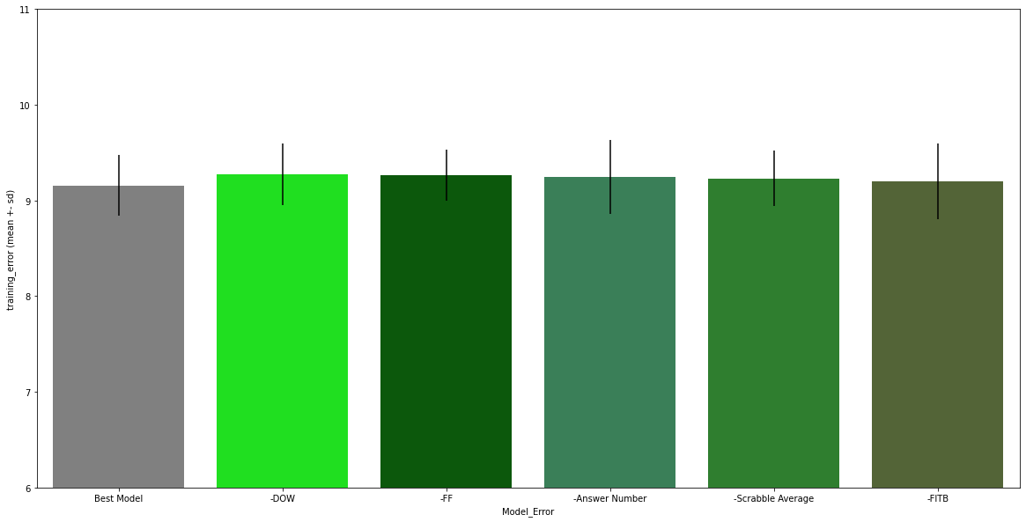
11
10
9
8
7
6
Full Best Model
Puzzle Day of Week
(DOW)
Freshness Factor
(Answer)
Answer #
(Grid)
Scrabble Average
(Answer)
Open Squares
(Grid)
(‘DOW_num’)
Subtracted Other Class Feature(s)

Slide 14
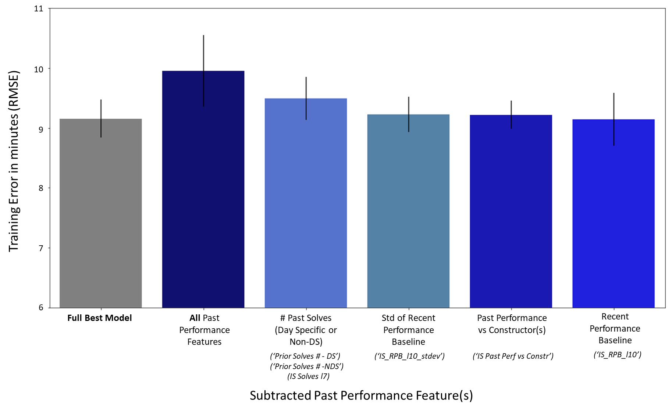
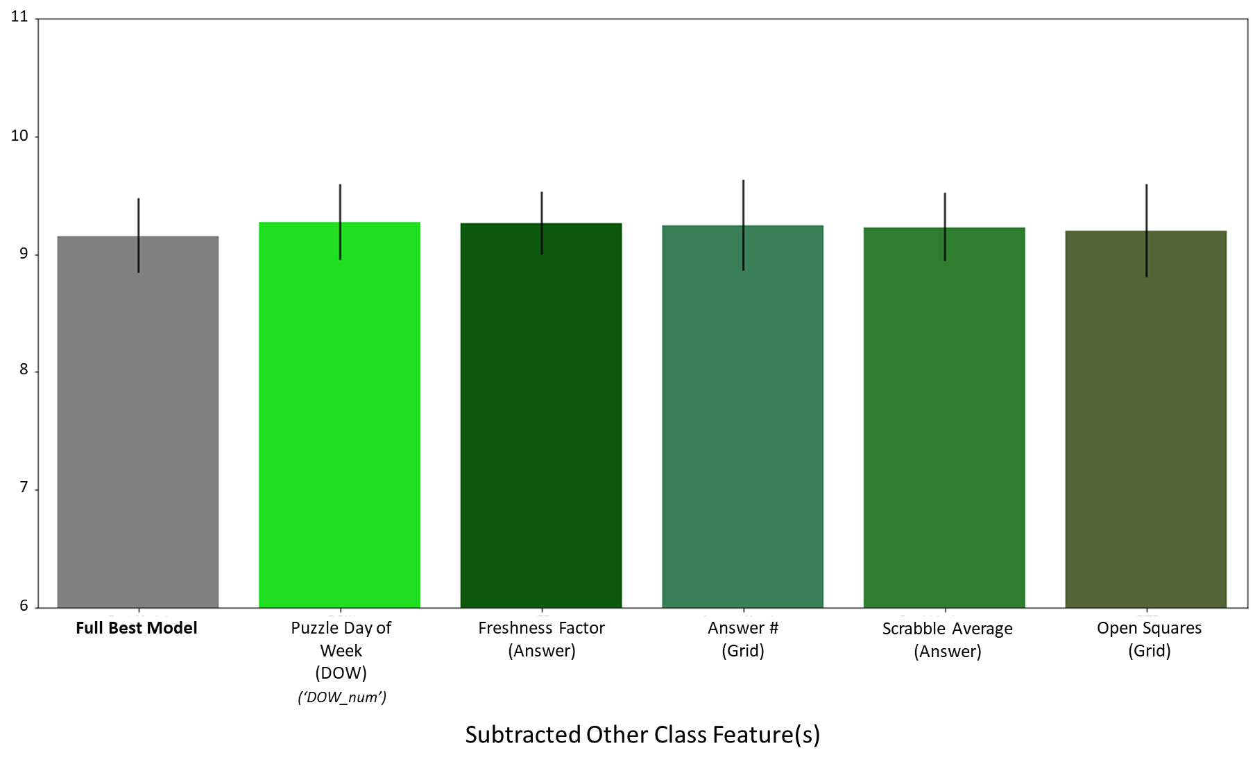
Notes:
Fig. 9

Slide 15
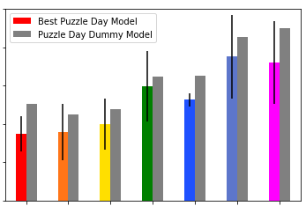
60
50
40
Training Error as % of mean solve time (RMSE)
30
20
10
Sun
Mon
Tue
Wed
Thu
Fri
Sat
Puzzle Day
Notes:
Fig. 10

Slide 16
Data Supplement

Slide 17
Puzzle Feature Name | Feature Class | Source(s) | Descriptions/Notes
IS2_ST(m) | Target | XWStats | Individual Solver 2 (IS2) raw solve time, in minutes, for a given 15x15 puzzle
IS_RPB_l10 | Past Performance | XWStats/Me | Strength of Schedule-adjusted mean of previous (to a given solve) 10 puzzles, for the relevant 15x15 puzzle day. Used as baseline in deriving ‘IS Past Perf vs Constr’ and ‘IS_per_sdp_avg_past_diff_from_RPB’.
IS_RPB_l10_stdev | Past Performance | XWStats/Me | Standard deviation of puzzle day-specific performance over same span as ‘IS_RPB_l10’ (recent solve variability)
IS Past Perf vs Constr | Past Performance | XWStats/Me | Past performance vs a specific constructor or constructor team; normalized to account for recent (past 10 puzzles) performance baseline per puzzle day (‘RPB’) and past puzzle day mix for constructor(s). Used SOS adjustment.
Prior Solves # - DS | Past Performance | XWStats/Me | Number of solves on a given 15x15 puzzle day prior to a solve to be predicted; experience proxy
Prior Solves # - NDS | Past Performance | XWStats/Me | Number of solves across all 15x15 puzzle days prior to a solve to be predicted; experience proxy
IS Solves l7 | Past Performance | XWStats/Me | Number of total solves in the past 7 days prior to a given puzzle solve
DOW_num | Puzzle Day of Week | Me | Assigns number to a given solve for the 15x 15 puzzle day of week (Mon-Sat)
Answer # | Grid | XWord Info | XWord Info calls answers “words”
Average Answer Length | Grid | XWord Info | XWord Info calls answers “words”
Blocks # | Grid | XWord Info | Blocks = black squares
Cheater Square # | Grid | XWord Info | Blocks than can be removed without affecting the overall word count of the grid
Circle # | Grid | XWord Info | Mostly seen in early week and Sunday puzzles
Open Squares # | Grid | XWord Info | Counts all white squares that are non-adjacent to black squares
Shade # | Grid | XWord Info | Counts all shaded squares in the grid; mostly seen in early week and Sunday puzzles
Spans # | Grid | XWord Info | Counts # of row or columns with 0 black squares (15 or 21 answer length, depending on grid size)
Stacks # | Grid | XWord Info | Counts # of times two or more adjacent rows or columns have all white squares (mostly Fri or Sat)
Unchecked Squares # | Grid | XWord Info | Squares that are part of only either the Across or Down clue, but not both
Unusual Symmetry | Grid | XWord Info | Assigns ‘1’ to all puzzles displaying other than normal rotational symmetry (e.g., L-R Mirror or Diagonal)
Cross Reference Clues # | Clue | XWord Info | Clue that refers to another clue (ex. “See 48-Down”)
Duplicate Clues # | Clue | XWord Info | When the same clue is used verbatim for more than one answer (uncommon)
Uniclue | Clue | XWord Info | When the same clue is used for both an Across and a Down entry (very rare)
Wordplay # | Clue | Manual (me) | Subjective count of clues displaying wordplay/punnery; many end with a ‘?’, ‘perhaps’, or ‘maybe’
Black Square Fill # | Answer | XWord Info | Number of black squares in the grid that contain at least one character (very rare)
Day Freshness %ile | Answer | XWord Info | Assigns percentile across all puzzles for the puzzle day of a given puzzle for Freshness Factor
Duplicate Answers # | Answer | XWord Info | When the same answer is used verbatim for more than one clue (rare)
Fill-in-the-Blank # | Answer | XWord Info | Number of fill-in-the-blank answers in a given puzzle
Freshness Factor | Answer | XWord Info | Assigns an overall rarity score to a puzzle’s answers, using both pre-Shortz and Shortz puzzles
Outside Grid # | Answer | XWord Info | Number of “virtual” squares outside the grid that contain at least one character (very rare)
Overall Freshness %ile | Answer | XWord Info | Assigns percentile across all puzzles from all puzzle days for Freshness Factor
Quantum | Answer | XWord Info | 1 denotes more than 1 valid answer for a clue (very rare)
Rebus # | Answer | XWord Info | Counts number of squares where more than one letter, number or symbol is required for a solve
Rebus Unique # | Answer | XWord Info | Same as above, but only counts squares with unique rebus content in the given puzzle
Scrabble Average | Answer | XWord Info | Treats each white square like a (non-blank) Scrabble tile and assigns per-square average point value
Scrabble Illegal # | Answer | XWord Info | Counts all answers that would not be playable based on the Official Scrabble Dictionary
Scrabble Score | Answer | XWord Info | Treats each white square like a (non-blank) Scrabble tile and assigns total point value for the puzzle
Unique Answer # | Answer | XWord Info | Counts all answers not occurring in any other pre-Shortz or Shortz Era puzzle
Unused Letters # | Answer | XWord Info | Counts the number (out of 26) of letters not used in a puzzle (0= pangram)
Completion Hour | Circadian | XWStats/Me | Hour of completion for a given puzzle
IS_per_sdp_avg_past_diff_from_RPB | Circadian | XWStats/Me | Measured how recent puzzle day-specific performance in the pertinent ‘Solve Day Phase’ (see below) compared to RPB across all solve phases. Used SOS-adjustment in deriving ‘RPB’.
Solve Day Phase | Circadian | XWStats/Me | Portion of 24 hour cycle a puzzle was solved in (1 = 12-6 AM; 2 = 6 AM-12 PM; 3 = 12 PM-6 PM; 4 = 6 PM-12 AM)
Notes:
Supp. Table 1

Slide 18
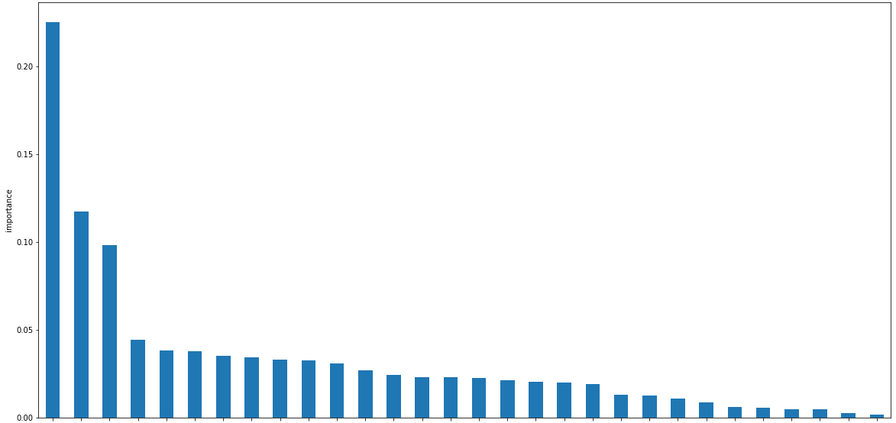
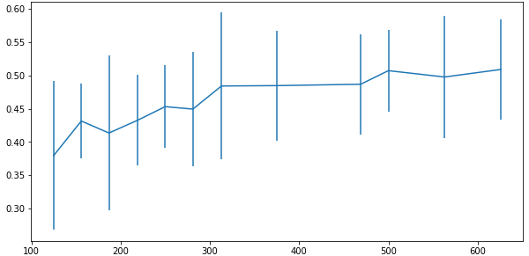
B
Best gradient boosting regressor feature importances
A
Cross-validation score as training set size increases
CV scores
Feature Importance
Training set size
RPB_l10
Blocks #
Answer #
Rebus #
Stacks #
DOW_num
IS Solves l7
Scrabble Score
Wordplay #
RPB_l10_stdev
Freshness Factor
Open Squares #
Scrabble Illegal #
Solve Day Phase
Rebus Unique #
Completion Hour
Unique Answer #
Unused Letters #
Fill-in-the-Blank #
Prior Solves # - DS
Day Freshness %ile
Scrabble Average
Cheater Square #
Duplicate Clues #
Prior Solves # - NDS
Average Answer Length
IS Past Perf vs Constr
Overall Freshness %ile
Cross Reference Clues #
IS_per_sdp_avg_past_diff_from_RPB

